Slide 1


Unsupervised Learning Sesi 1
Special Crafted by
Training series no.
Bootcamp Publik
Updated
28 April 2018

Slide 2
Agenda (Sesi 1 dan 2)
Tujuan Pembelajaran - Memahami unsupervised learning dan beberapa tipe clustering
Topik:
Apa itu unsupervised learning?
Apa itu K-Means Clustering?
Apa itu Hierarchical Clustering? ---------------- di sesi 2 Apa itu C-Means Clustering?---------------- di sesi 2
Hands on:
Praktik K-means Clustering di R
Praktik Hierarchical Clustering di R ---------------- di sesi 2
Praktik Fuzzy C-means Clustering di R ----------------------di sesi 2

Slide 3
Type of Machine Learning
3 Main types of machine learning:
Unsupervised learning
Goal is to find structure in unlabeled data
Unlabeled data is data with no targets
Supervised learning
Regression or classification
Goal is to predict the amount or the label
Reinforcement learning
A computer learns by feedback from operating in a real or synthetic environment

Slide 4
Labeled vs Unlabeled Data
Warna | Bentuk | Luas
Biru | Lingkaran | 10 cm2
Kuning | Persegi | 12 cm2
Hitam | Setengah Lingkaran | 10cm2
Kelompok
1
2
3

Slide 5
Goals of Unsupervised Learning
Two major goals (1):
To Find homogenous subgroups within a population
This is called clustering
Example: segmenting a market of consumers based on demographic features and purchasing history
Example: find similar movies based on features of each movie and reviews of the movies

Slide 6

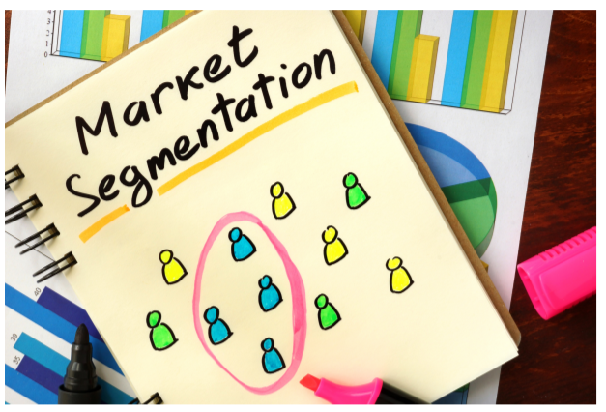


Unsupervised Learning

Slide 7
Goals of Unsupervised Learning
Two major goals (1&2):
To Find homogenous subgroups within a population
This is called clustering
Example: segmenting a market of consumers based on demographic features and purchasing history
Example: find similar movies based on features of each movie and reviews of the movies
To find patterns in the features of the data
Dimensionality reduction - a method to decrease the number of features to describe an observation while maintaining the maximum information content under the constraints of lower dimensionality

Slide 8
Dimensionality Reduction
Find patterns in the features of the data
Visualization of high dimensional data
Pre-processing before supervised learning

Slide 9
Challenges and Benefit
No single goal of analysis
Requires more creativities
Much more unlabelled data compared to cleanly labelled data.

Slide 10
Quiz
Which of the following are clustering problems?
Determining how many features it takes to describe most of the variability in data
Determining the natural groupings of houses for sale based on size, number of bedrooms, etc.
Visualizing 13 dimensional data (data with 13 features)
Determining if there are common patterns in the demographics of people at a commerce site
Predicting if someone will click on a web advertisement

Slide 11
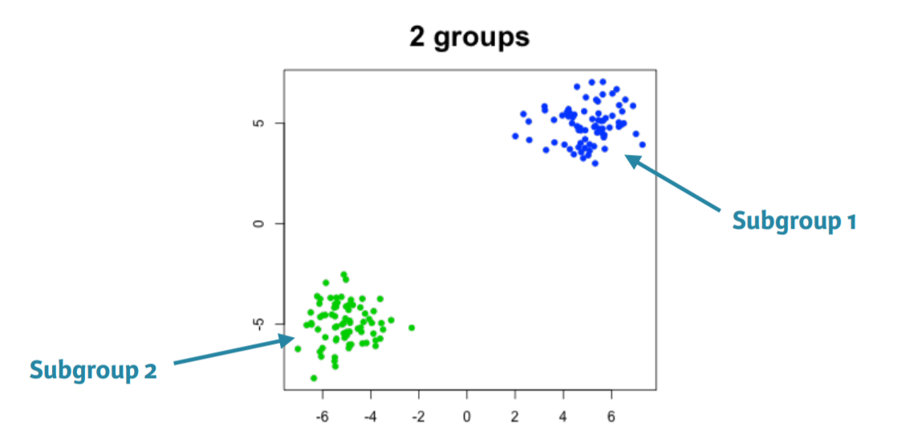
Intro to K-Means Clustering
What is it for?
An algorithm used to find homogeneous subgroups in a population.
Notes:
This kmeans comes in base R
Need the data
Number of centers or groups
Number of runs. Its start by randomly assigning points to groups and you can find local minimums so running it multiple times helps you find the global min.

Slide 12
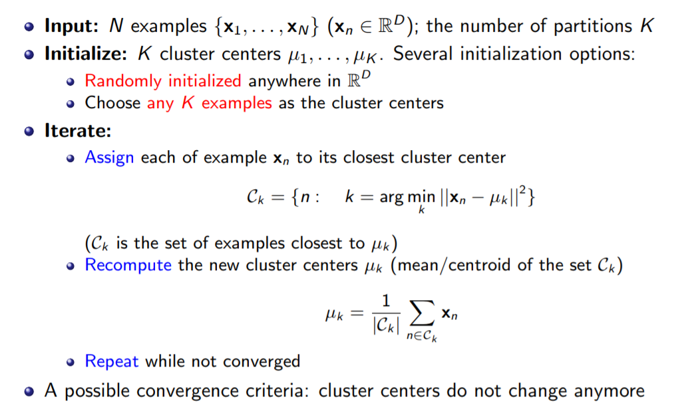
How K-Means Works?

Slide 13
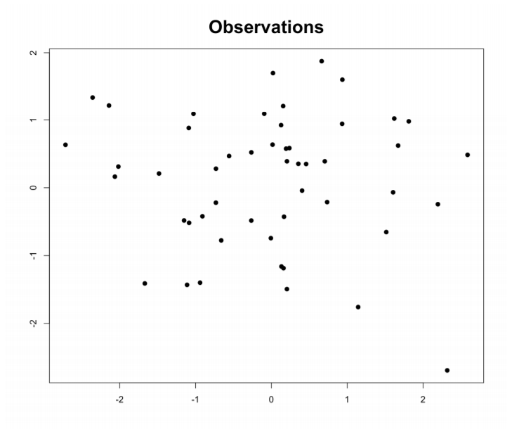
How K-Means works?
Notes:
This kmeans comes in base R
Need the data
Number of centers or groups
Number of runs. Its start by randomly assigning points to groups and you can find local minimums so running it multiple times helps you find the global min.

Slide 14
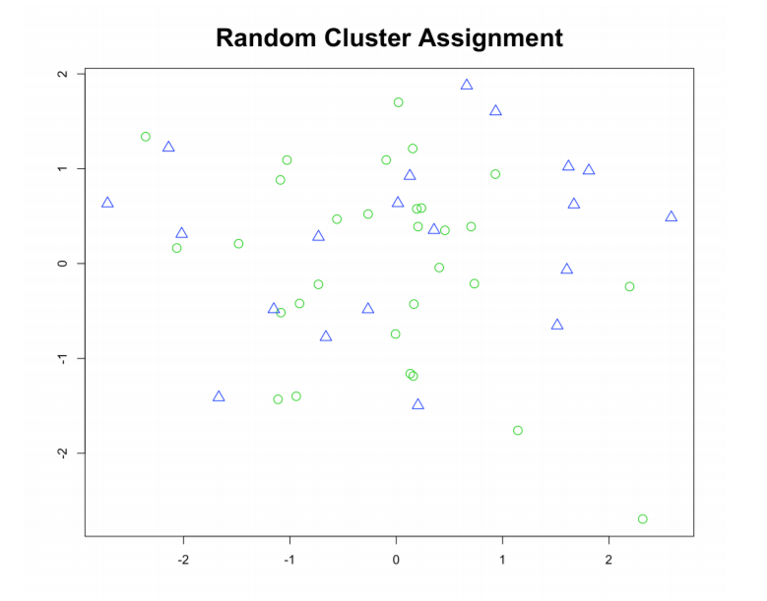
How K-Means works?
Notes:
This kmeans comes in base R
Need the data
Number of centers or groups
Number of runs. Its start by randomly assigning points to groups and you can find local minimums so running it multiple times helps you find the global min.

Slide 15
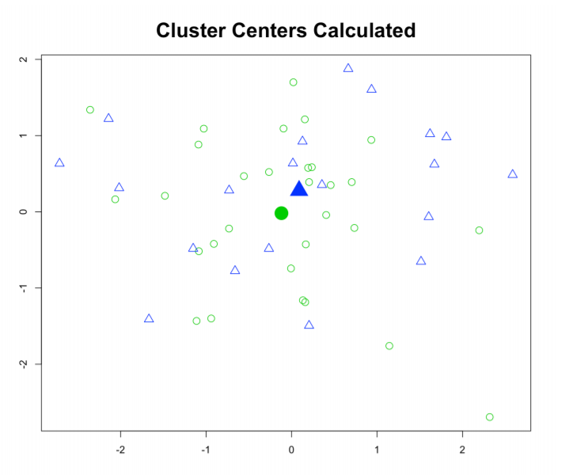
How K-Means works?
Notes:
This kmeans comes in base R
Need the data
Number of centers or groups
Number of runs. Its start by randomly assigning points to groups and you can find local minimums so running it multiple times helps you find the global min.

Slide 16
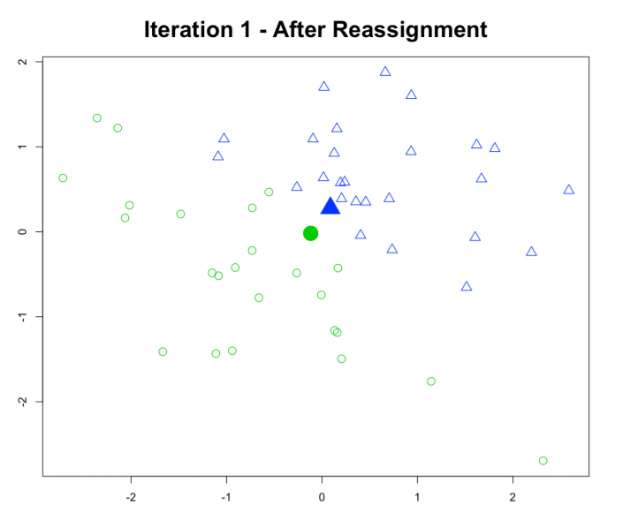
How K-Means works?
Notes:
This kmeans comes in base R
Need the data
Number of centers or groups
Number of runs. Its start by randomly assigning points to groups and you can find local minimums so running it multiple times helps you find the global min.

Slide 17
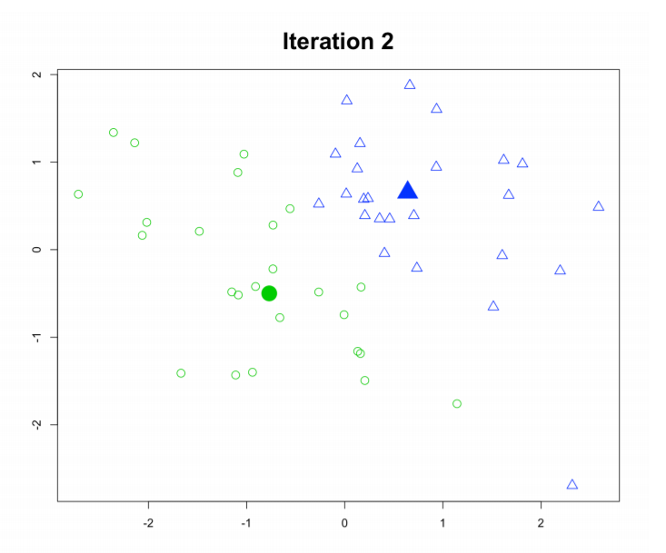
How K-Means works?
Notes:
This kmeans comes in base R
Need the data
Number of centers or groups
Number of runs. Its start by randomly assigning points to groups and you can find local minimums so running it multiple times helps you find the global min.

Slide 18
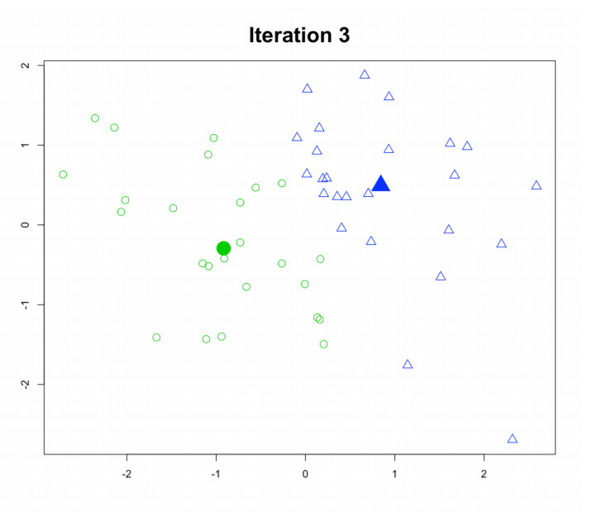
How K-Means works?
Notes:
This kmeans comes in base R
Need the data
Number of centers or groups
Number of runs. Its start by randomly assigning points to groups and you can find local minimums so running it multiple times helps you find the global min.

Slide 19
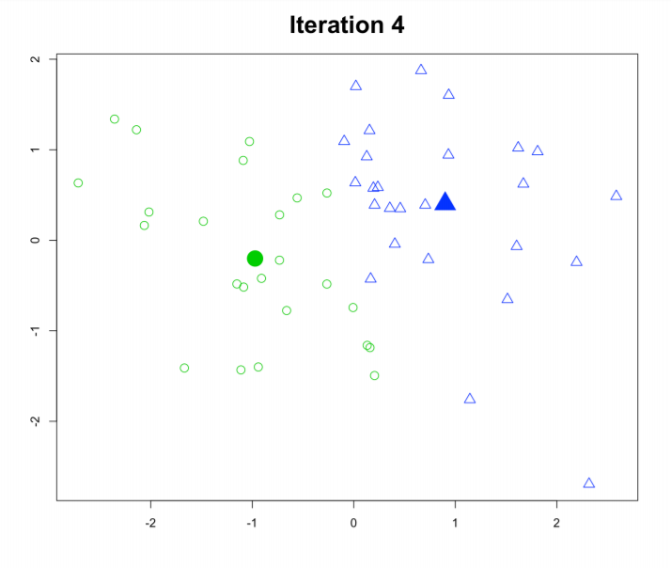
How K-Means works?
Notes:
This kmeans comes in base R
Need the data
Number of centers or groups
Number of runs. Its start by randomly assigning points to groups and you can find local minimums so running it multiple times helps you find the global min.

Slide 20
How K-Means works?
Notes:
This kmeans comes in base R
Need the data
Number of centers or groups
Number of runs. Its start by randomly assigning points to groups and you can find local minimums so running it multiple times helps you find the global min.

Slide 21
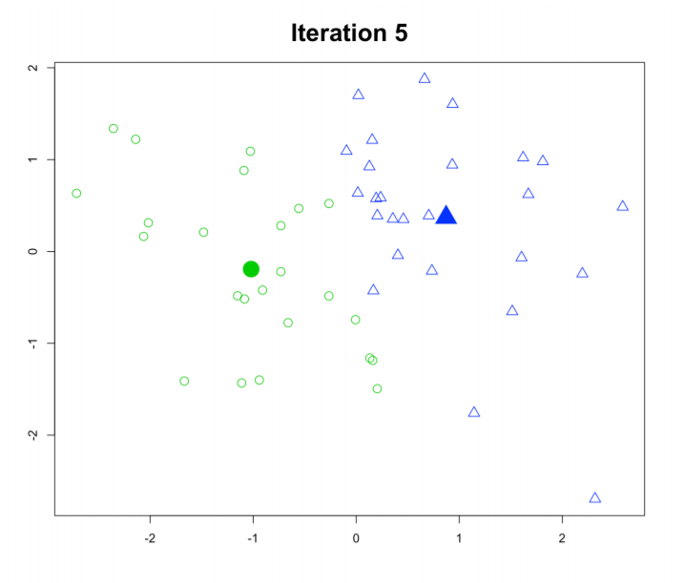
How K-Means works?
Notes:
This kmeans comes in base R
Need the data
Number of centers or groups
Number of runs. Its start by randomly assigning points to groups and you can find local minimums so running it multiple times helps you find the global min.

Slide 22
K-Means in R
# k-means algorithm with 3 clusters, run 10 times.
kmeans(x, centers=3, nstart=10)
data
Number of cluster
Running times
One observation per row, one feature per column
k-means has a random component
Run algorithm multiple times to improve odds of the best model
Notes:
This kmeans comes in base R
Need the data
Number of centers or groups
Number of runs. Its start by randomly assigning points to groups and you can find local minimums so running it multiple times helps you find the global min.

Slide 23
Model Selection
Recall k-means has a random component
Best outcome is based on total within cluster sum of squares:
For each cluster
For each observation in the cluster
Determine squared distance from observation to cluster center
Sum all of them together
Notes:
This kmeans comes in base R
Need the data
Number of centers or groups
Number of runs. Its start by randomly assigning points to groups and you can find local minimums so running it multiple times helps you find the global min.

Slide 24
How to determine number of Cluster?
screen plot
look for the elbow
find where addition on new cluster does not change best within much
there is no clear elbow in real world data

Slide 25
How to determine number of Cluster?
screen plot
look for the elbow
find where addition on new cluster does not change best within much
there is no clear elbow in real world data

Slide 26
Praktik…
Let’s Coding!

Slide 27
Takeway for Today
Unsupervised vs. supervised learning
How to create k-means cluster model in R
How k-means algorithm works
Model selection

Slide 28
Next Season (Unsupervised Learning 2)
Topik:
Apa itu unsupervised learning?
Apa itu K-Means Clustering?
Apa itu Hierarchical Clustering? ---------------- di sesi 2 Apa itu C-Means Clustering?---------------- di sesi 2
Hands on:
Praktik K-means Clustering di R
Praktik Hierarchical Clustering di R ---------------- di sesi 2
Praktik Fuzzy C-means Clustering di R ----------------------di sesi 2

Slide 29


Beyond Data and Technology
IYKRA merupakan Knowledge & Credential provider yang fokus membangun professional di bidang data, teknologi, bisnis dan inovasi.
Didirikan oleh kumpulan professional yang sudah memiliki pengalaman lebih dari 10 tahun
Didukung oleh Data Science Indonesia, jaringan professional yang sudah berpengalaman lebih dari 2 tahun membangun dan mengedukasi pemanfaatan data di indonesia.
Expert Network Force
Of Data, Business, technology and innovation
> 10 years experience Of Data, Business, technology and innovation

Slide 30
Contact:
Bernardus Ari Kuncoro
Ari.kuncoro@iykra.com
http://arikuncoro.xyz
IYKRA
Ariobimo Sentral Kuningan, Block 71 Lantai 8.
Jl. HR Rasuna Said Blok X-2, Kav. 6, Kuningan
Jakarta 12950
Thank you

